Slide 1
Reading with Kids A-Z “How to”
Karen Mengel, Title 1 Teacher
Unified School District of Marshfield
mengel@marshfieldschools.org

Slide 2
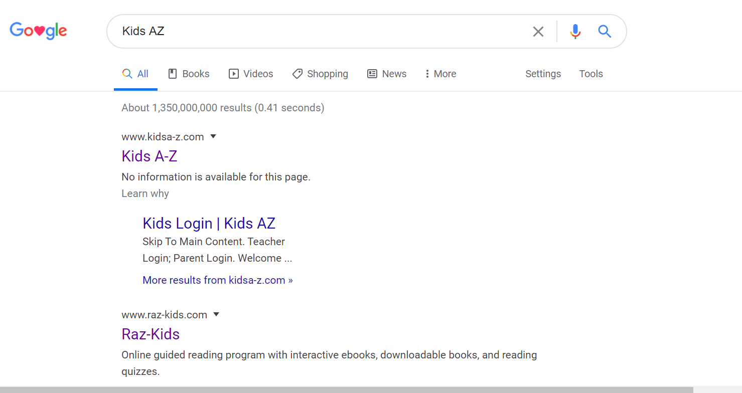
Step 1 – Search Kids A-Z
https://www.kidsa-z.com/

Slide 3
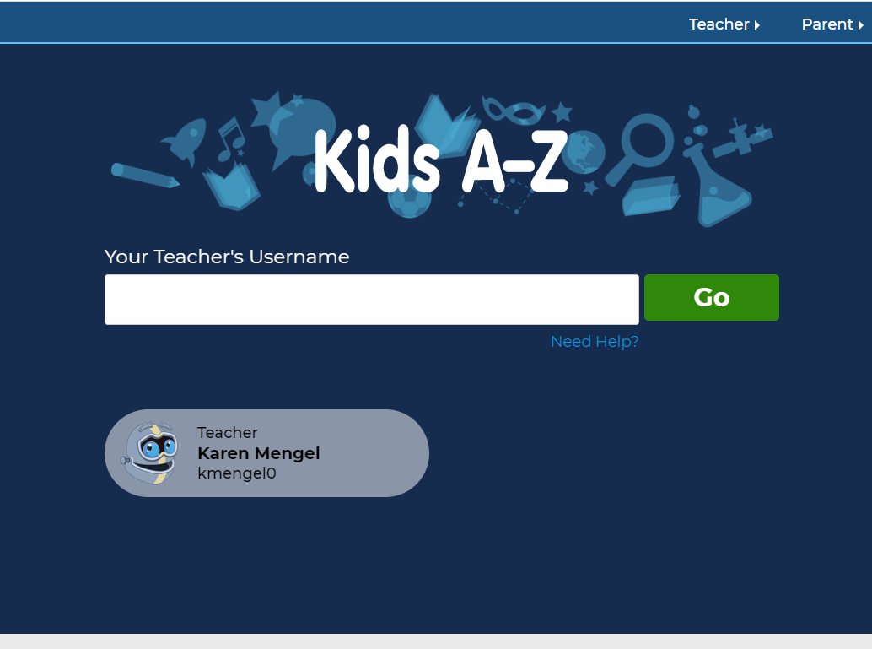
Step 2- Locate Your Child’s Teacher’s Account
You should have received a notification and login information if your child has been added to a Kids A-Z roster.
Click on your child’s teacher’s username icon if you see it.
OR
If you do not see your child’s teacher’s icon, type their teacher’s username in the search bar and click go. If you do not have their teacher’s username, contact your child’s teacher.

Slide 4
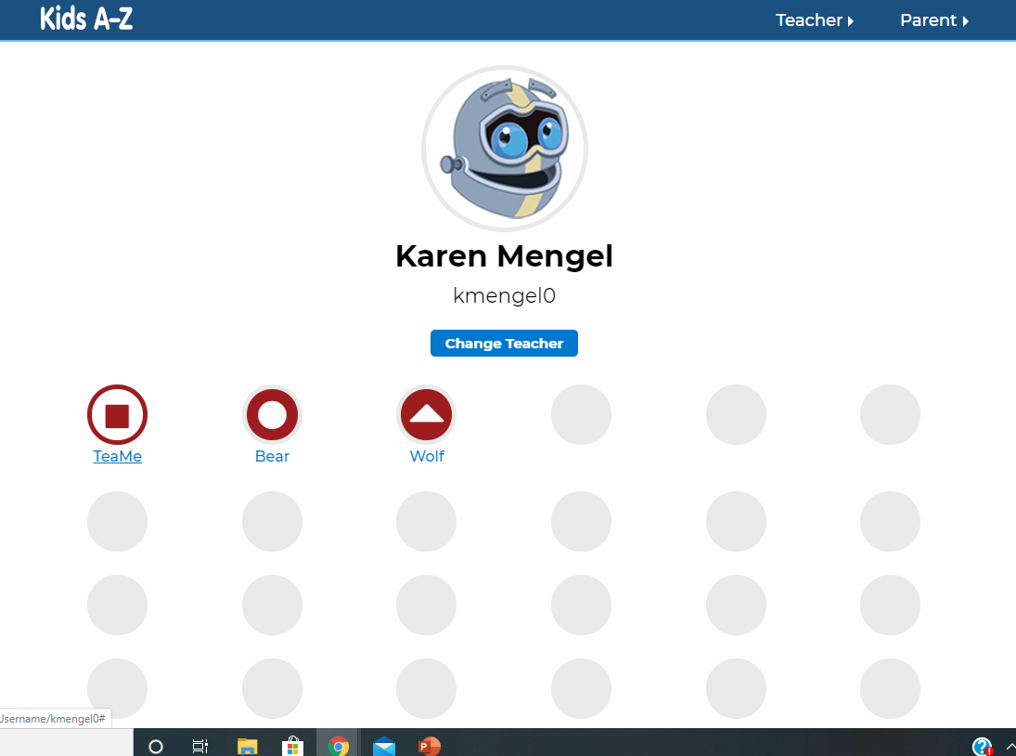
Step 3- Locate Your Child’s Username
Click on your child’s username icon (*your child’s username should be initials, first name, or another username that their teacher created).

Slide 5
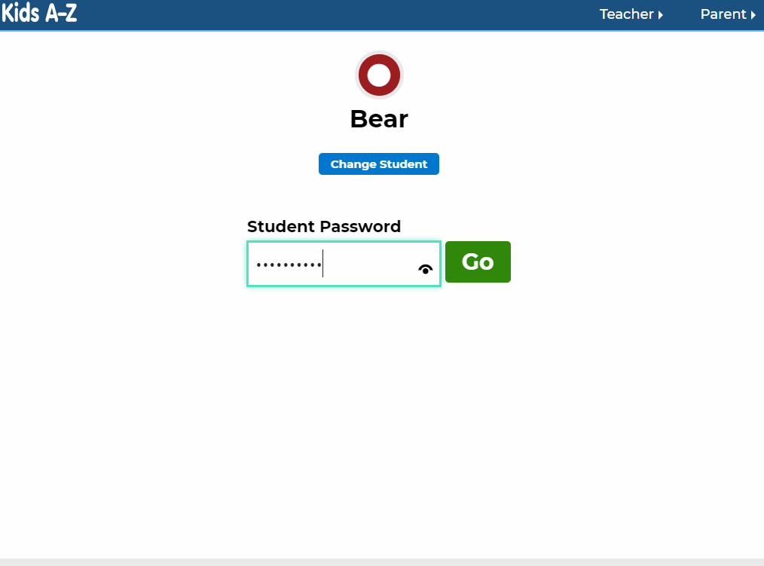
Step 4- Enter Your Child’s Password
Your child will be given a password from their teacher. The password may include letters and numbers or pictures, (ex. a turtle, rocket ship, etc.).
Enter the password and click go.

Slide 6
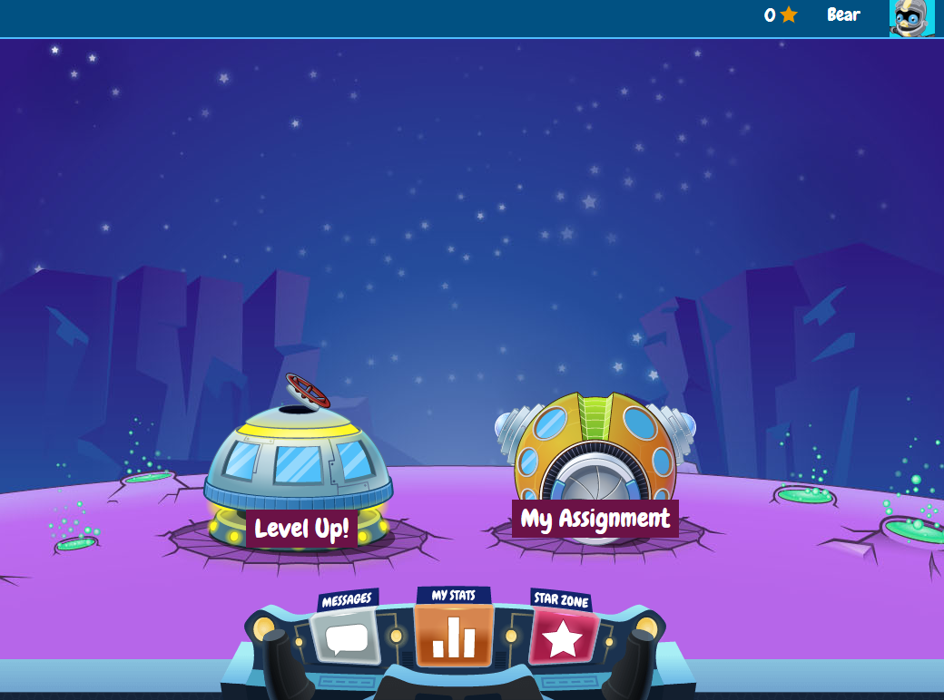
Step 5- Select Level Up! or My Assignment
It is a good idea to check for assignments from My Assignments before entering Level Up!. This helps your child to get assignments completed so that feedback can be provided.
Not all teachers create assignments for their students.
Assignments are optional. However, assignments have been carefully selected for your child as a measure of their progress and will help your child’s teacher gain insight on progress with key skills.

Slide 7
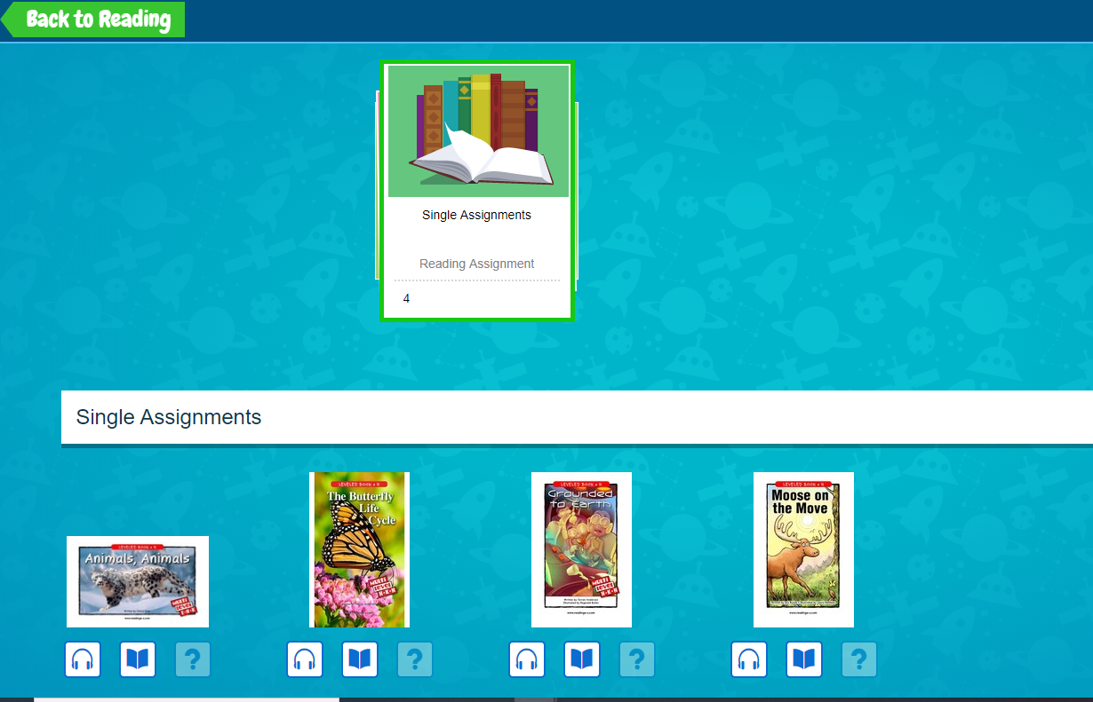
Step 6- Completing Assignments
If your child has an assignment, click on the book that they would like to complete first. It doesn’t matter what order assignments are completed in.
Students have the option of listening to a book or reading it. Click on the headphone icon to listen or the book icon to read the book selected.
Your child should click on the question mark icon to take a quiz. Students should take a quiz only after they have listened to the book and have read it.
Not all books have quizzes.

Slide 8
Listening to a Book-
pause
When ready to listen to a book, click the green arrow icon to begin. Students should read along silently while listening to the book.
Students will notice three additional icons once they begin listening (red pause icon / green arrow icon (when paused)), back button, and next button). They will need to use these icons and buttons to move through the book. The book will automatically advance once started, but if the book is paused your child will need to decide which icon and buttons they need to use to continue in the book.
Your child may want to use the back button if they need to reread a previous page, or the next button to move to a new page.
start
play

Slide 9
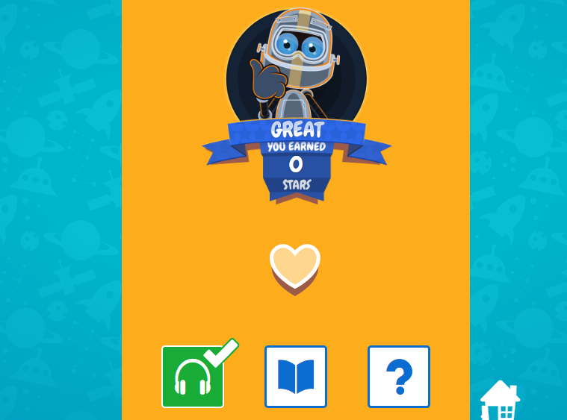
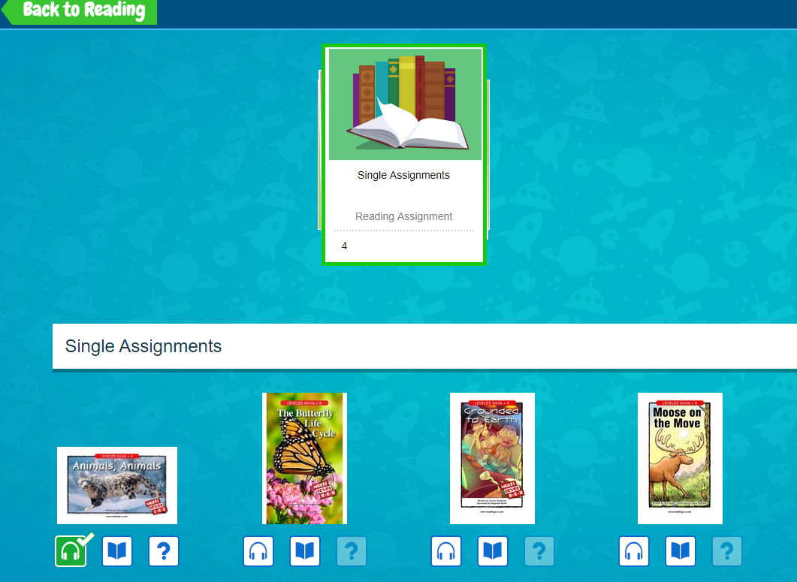
Listening to a Book (cont’d)
Your child must listen to the entire book to receive points. The points display at the end of the book once the next button is clicked. Fewer points are awarded for listening to a book than reading a book.
Your child should read the book next. They will need to click the book icon to begin reading.
The home button will take your child back to assignments if they would like to read or take a quiz at a different time.
Your child may add the book to favorites by clicking the heart icon. They will be able to read the book as many times as they like, but your child will only receive points during the first reading.

Slide 10
Reading a Book
Your child may record, highlight, etc. while reading a book on their own.
The speaker icon at the top of the book is for recording their voice while reading.
Your child can notate their assignment by clicking on the tools icon. Once clicking on the tools icon, your child will find icons for writing, highlighting, stamping, or undoing notations.
Your child can click the comments icon to make a comment.
The notebook icon is a journal that allows your child to write and reflect on their reading.

Slide 11
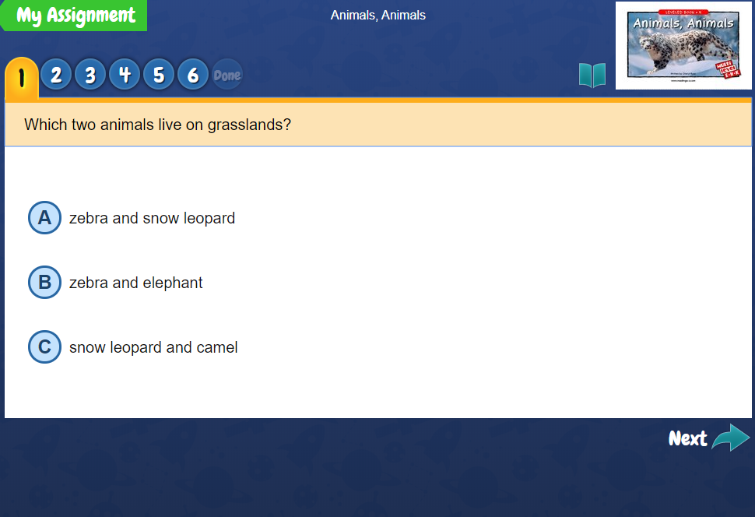
Taking a Quiz
Your child may take a quiz once they have listened to a book and have read the book.
Kids A Z quizzes assess specific literacy skills needed to read and comprehend books at each level.
All quiz questions are based on what your child reads.
Encourage your child to think about each question and go back into the text if they are unsure of the answer. Use the blue book icon at the top of your screen to go back to the book.

Slide 12
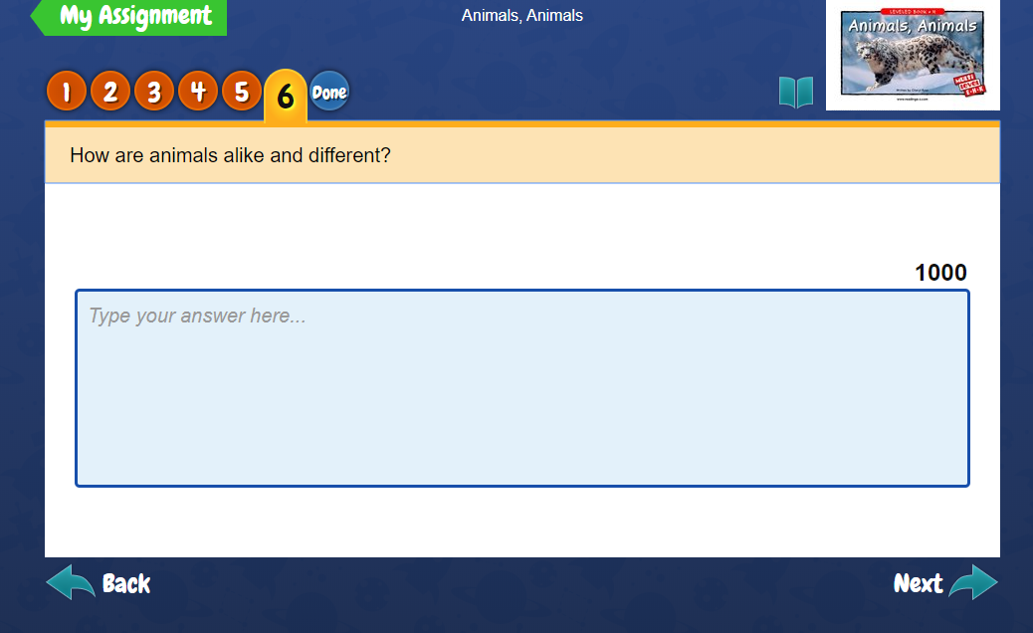
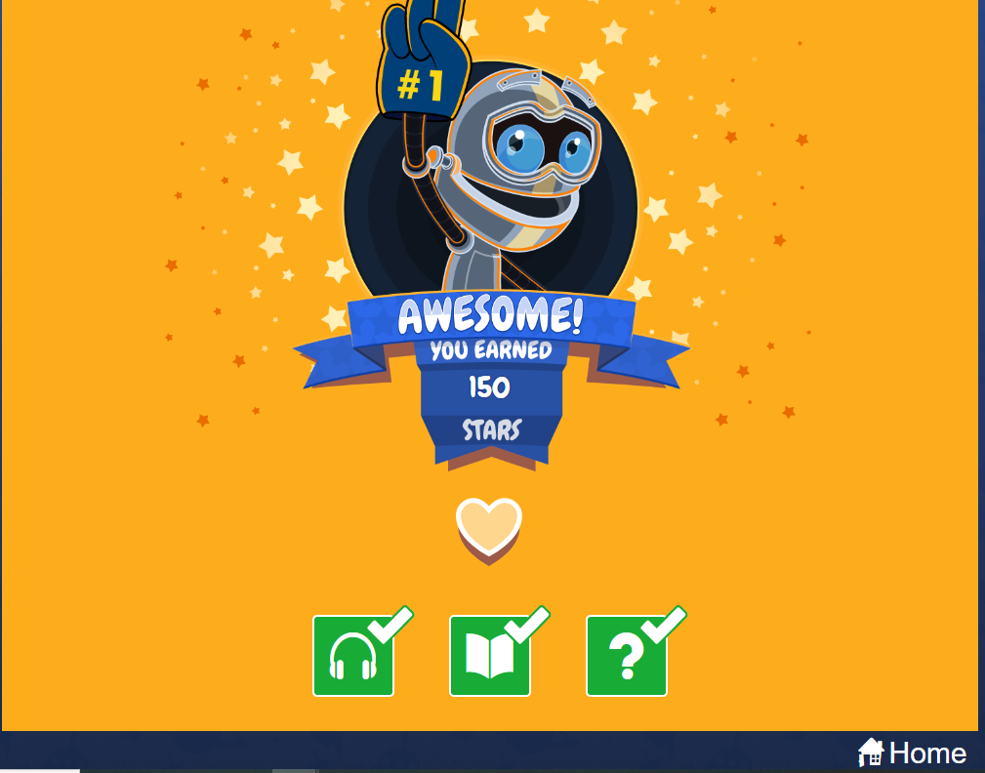
Taking a Quiz
Each time your child answers a question, they must click the next button in order to move on.
The last question of a quiz may or may not include a writing prompt. This depends on what your child’s teacher has assigned to them. If they need to provide a response, simply click in the blue box and begin typing. Your child’s teacher will read and score the response.
Once your child has provided a response, they should click the button that says “Done”.
Feedback and points will be provided when the “Done” button is selected.
Your child should click the home button once completed.

Slide 13
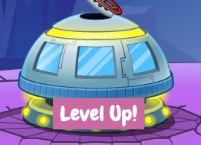
Reading for Enjoyment
The best part of using the Kids AZ app or website is the wide range of books offered that appeal to your child’s interests. Once your child completes their weekly assignment, have them click the back to reading button. Your child will be taken to their dashboard page.
Your child can click on Level Up! to find other books to read. They can also go into the reading room if they see that button on their home page.

Slide 14
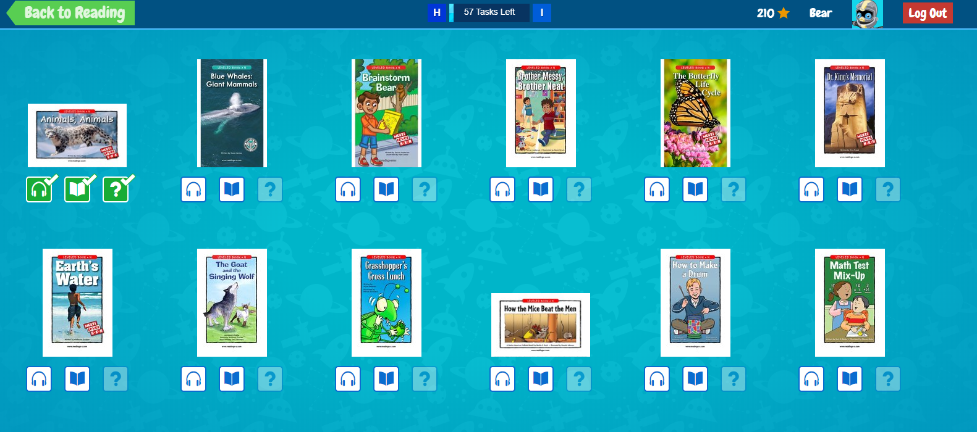
Reading for Enjoyment
Your child may read any books that are featured in the Level Up! section. They will need to read all the books featured at each level in order to move to the next level. If books do not seem to be a good fit for your child contact their teacher for assistance through the built-in message system.
If your child is finished, they may click on the logout button.

Slide 15
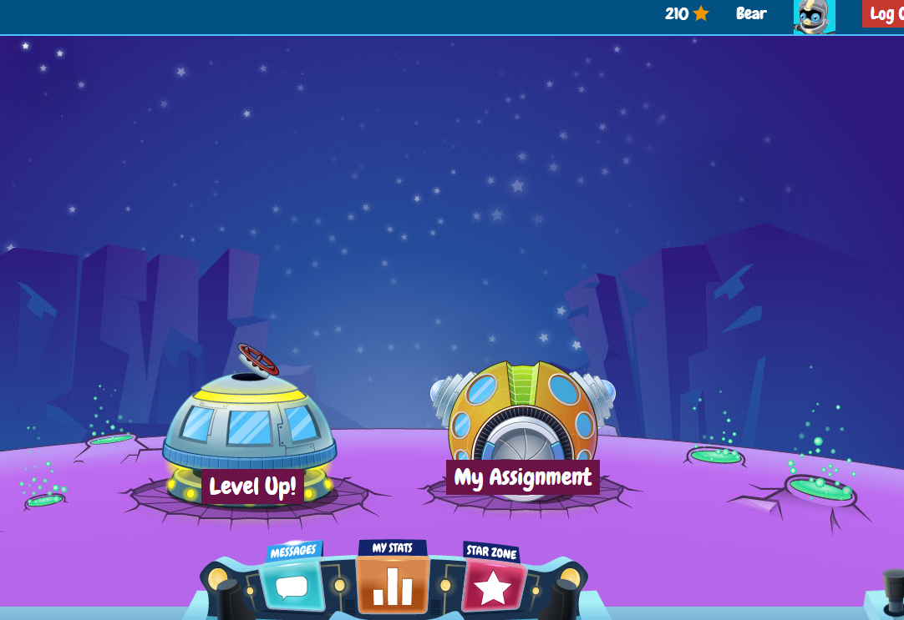
Additional Features
There are several additional features that can be found on your child’s dashboard page at Kids A-Z.
The dashboard offers messages, stats, and the star zone. I will review these features and ways that parents can access their child’s account in a follow-up presentation.

Slide 16
Thank you!
Thank you for all you do to help your child build their literacy skills.
If you have questions or concerns regarding Kids A-Z please contact me at mengel@marshfieldschools.org or contact your child’s classroom teacher.

Slide 17
End Notes
This Power Point was created for families in the Unified School District of Marshfield. All screen shots were taken from the Kids A-Z website for the sole purpose of educating families on how to use the website. Kids A-Z is not affiliated with USDoM.
Login information will be provided to students whose teachers have access to Kids A-Z.
Kids A-Z is also available for Android and iPad through app stores.
Please check with your child’s teacher for access. Not all district teachers have access to Kids A-Z

